Slide 1
SRE Presentation
Friday 29th March 2019

Slide 2
What is SRE?
SRE stands for Sex and Relationship Education.
It is delivered as part of the PSHE (Personal, Social and Health Education) curriculum.
As a Catholic school we are expected to follow a scheme of work that reflects the Catholic ethos.

Slide 3
The SRE scheme of work
The scheme we will be using is called ‘Journey in Love’.
This is the scheme that has been provided by Plymouth CAST under canonical approval and is being used in all of the CAST schools.

Slide 4
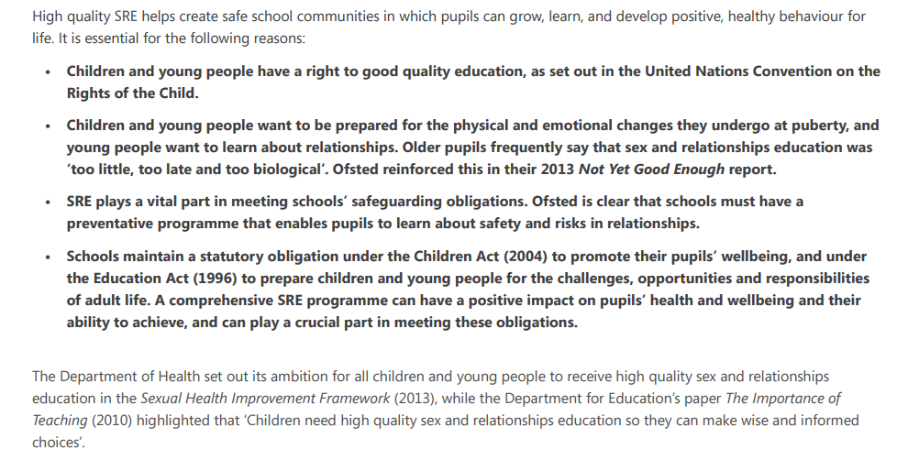
Why do we teach SRE in school?
This is taken from Department for Education guidance:

Slide 5
So, what will the children learn?
A breakdown of each year group

Slide 6
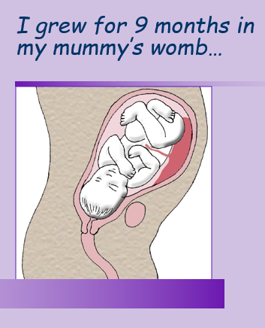
Reception class
The children will talk about being how they are different and will celebrate their ‘uniqueness’.
They will learn about how they grew in their mummy’s womb for 9 months.
They will explore what it means to be a friend.

Slide 8
Year 1
The children will look at the different people who are part of our families.
They will share ideas on the way that babies grow and develop once they are born.

Slide 10
Year 2
The children will talk about different communities that they belong to.
They will look at the different roles within communities e.g. doctor, nurse, cleaner, police officer, teacher etc.
They will look at how communities can share sad and happy times.

Slide 12
Year 3
The children will think about the different people who look after them.
They will then move on to think about the different ways they look after themselves.
They will talk about how they are changing and explore friendships.

Slide 14
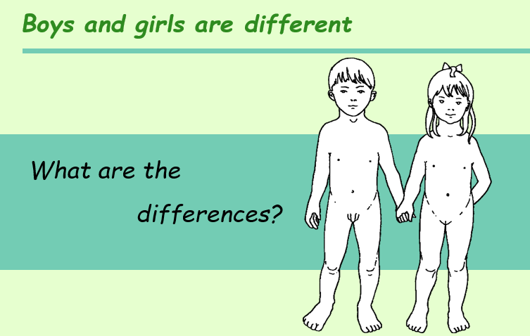
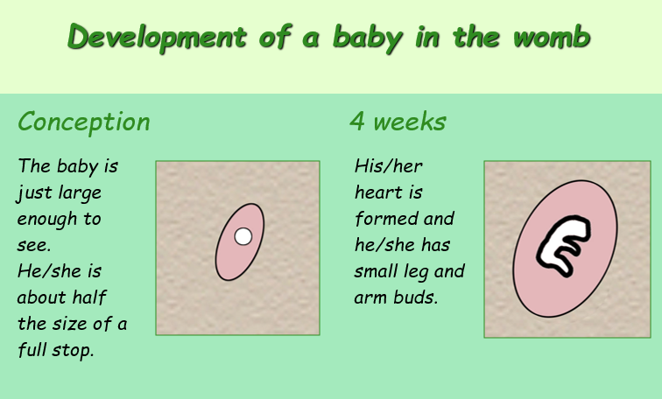
Year 4
The children will talk about the difference between boys and girls.
They will look at the development of the baby in the womb (no reference is made to how conception takes place).

Slide 16
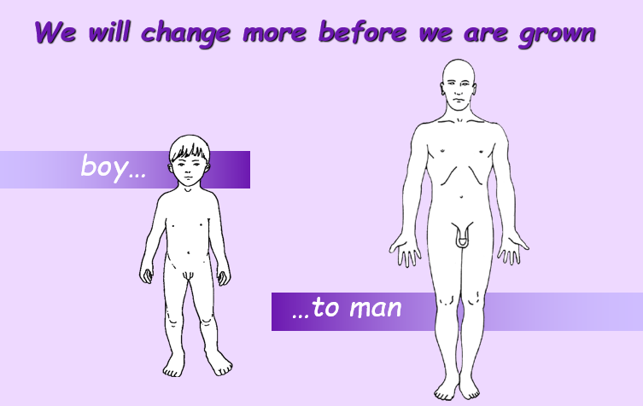
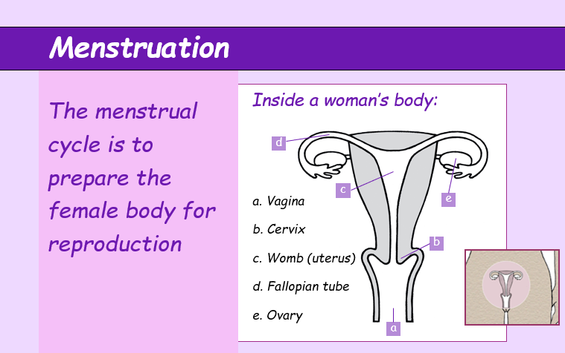
Year 5
The children will learn about the physical changes that will take place during puberty.
They will learn about periods.
They will discuss the emotional changes that might go along with the physical changes.

Slide 18
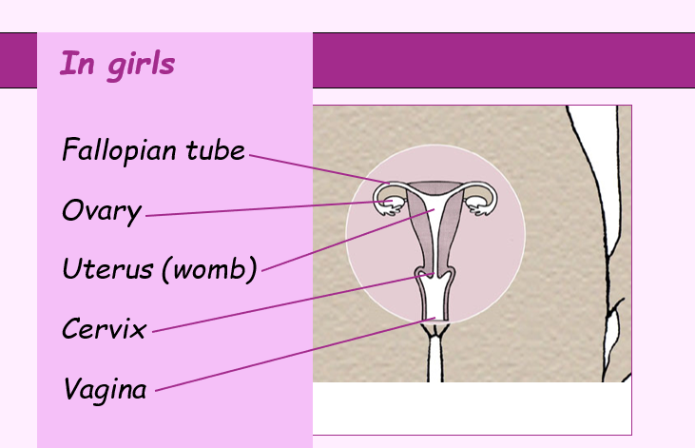
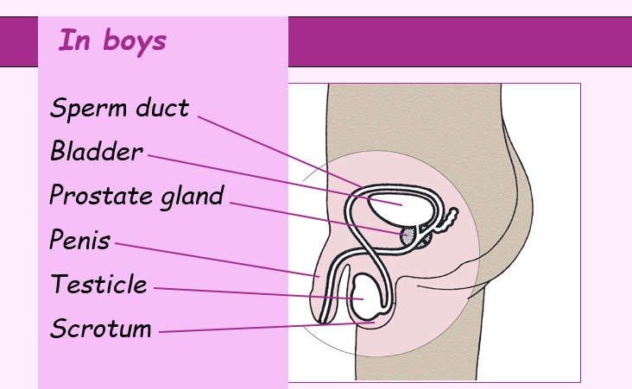
Year 6
The children will look at the physical differences between girls and boys.
They will hear the term ‘sexual intercourse’.
They will then look at the growth and development of a baby through pregnancy.

Slide 20
Any questions?

